Slide 1
Mobile Computing
Wireless Communication Systems

Slide 2
Mobile phone subscribers worldwide
approx. 1.7 bn
1600
1400
1200
GSM total
1000
TDMA total
CDMA total
Subscribers [million]
PDC total
800
Analogue total
600
W-CDMA
Total wireless
Prediction (1998)
400
200
0
1996
1997
1998
1999
2000
2001
2002
2003
2004
year

Slide 3
Telecommunication Systems
The graphs of mobile and fixed users crossed in March 2002.
GSM, TDMA, CDMA, and PDC are all second generation systems.
GSM is heavily dominating the current market.
System architecture served many other systems as an early example.

Slide 4
GSM
Formerly: Groupe Spéciale Mobile (founded 1982)
Now: Global System for Mobile Communication.
The primary goal of GSM
To provide a mobile phone system that allows users to roam throughout Europe and provides voice services compatible to ISDN and other PSTN systems.
GSM 900, GSM 1800, GSM 1900, GSM 400, GSM R

Slide 5
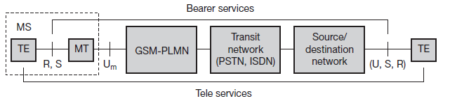
GSM: Mobile Services
Permits the integration of different voice and data services and the interworking with existing networks.
Categories of services:
Bearer, Tele, and Supplementary services.
Reference model for GSM services

Slide 6
Contnd..
A mobile station MS is connected to the GSM public land mobile network (PLMN) via the Um interface.
This network is connected to transit networks, e.g., integrated services digital network (ISDN) or traditional public switched telephone network (PSTN).
There might be an additional network, the source/destination network, before another terminal TE is connected.
The mobile termination (MT)
Performs all network specific tasks (TDMA, FDMA, coding etc.) within the mobile station MS, and offers an interface for data transmission (S) to the terminal TE which can then be network independent.

Slide 7
Bearer Services
Comprise all services that enable the transparent transmission of data between the interfaces to the network.
Permit transparent and non-transparent, synchronous or asynchronous data transmission.
Transparent bearer services
Only use the functions of the physical layer (layer 1) to transmit data.
Data transmission has a constant delay and throughput if no transmission errors occur.
To increase transmission quality, use Forward Error Correction
Data rates of 2.4, 4.8, or 9.6 kbit/s

Slide 8
Contnd..
Non-transparent bearer services
Use protocols of layers two and three to implement error correction and flow control.
A radio link protocol (RLP) added to the transparent bearer services.
This protocol comprises mechanisms of
high-level data link control (HDLC), and
Special selective-reject mechanisms to trigger retransmission of erroneous data.
Now throughput and delay may vary depending on transmission quality.

Slide 9
Contnd..
Data transmission can be
Full-duplex, synchronous with data rates of 1.2, 2.4, 4.8, and 9.6 kbit/s
Full-duplex, asynchronous from 300 to 9,600 bit/s

Slide 10
Tele Services
Focuses on voice-oriented tele services.
Provision of high-quality digital voice transmission
Emergency number
Same number can be used throughout Europe.
Mandatory service from all providers and free of charge.
Has the highest priority,
Possibly pre-empting other connections,
Will automatically be set up with the closest emergency center.

Slide 11
Contnd..
Message services
Short Message Service (SMS)
160 characters.
Do not use the standard data channels of GSM
Exploit unused capacity in the signalling channels. Sending and receiving of SMS is possible during data or voice transmission.
Can also transfer logos, ring tones, horoscopes
SMS is typically the only way to reach a mobile phone from within the network.
Used for updating mobile phone software.

Slide 12
Contnd..
Enhanced Message Service (EMS)
offers a larger message size
formatted text, and the transmission of animated pictures, small images and ring tones in a standardized way.
Multimedia Message Service (MMS)
Offers the transmission of larger pictures (GIF, JPG, WBMP), short video clips etc.
Group 3 fax
Fax data is transmitted as digital data over the analog telephone network using modems.
Fax data and fax signaling is transmitted using a transparent bearer service.

Slide 13
Supplementary Services
User identification,
Call redirection,
Forwarding of ongoing calls.
Standard ISDN features such as
Closed user groups
Multiparty communication

Slide 14
GSM Features
SIM
On-the air privacy
Encrypting the digital bit stream sent by the transmitter using secret key.

Slide 15
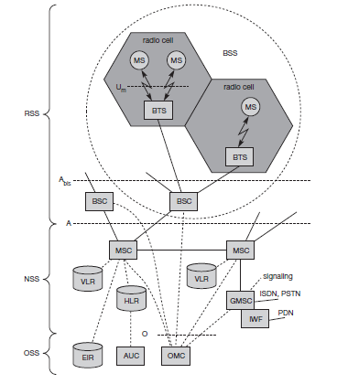
System architecture

Slide 16
GSM Subsystems
The radio sub system (RSS)
The network and switching subsystem (NSS)
The operation subsystem (OSS)

Slide 17
The radio Sub System (RSS)
The mobile stations (MS)
Comprises all user equipment and software needed for communication with a GSM network.
Consists of user independent hard- and software and of the subscriber identity module (SIM).
Stores all user-specific data that is relevant to GSM.
Contains many identifiers and tables, such as card-type, serial number, a list of subscribed services, a personal identity number (PIN), a PIN unblocking key (PUK), an authentication key Ki, and the international mobile subscriber identity (IMSI).
MS can be identified via the international mobile equipment identity (IMEI)

Slide 18
Contnd..
The MS stores dynamic information while logged onto the GSM system,
The cipher key Kc
The location information consisting of a temporary mobile subscriber identity (TMSI)
The location area identification (LAI)
Apart from the telephone interface MS can also offer other types of interfaces to users.
With display, loudspeaker, microphone, and programmable soft keys, computer modems, IrDA, or Bluetooth.
Vendor - specific functions and components.
Cameras, fingerprint sensors, calendars, address books, games, and Internet browsers, location tracking etc.

Slide 19
RSS
The base station subsystem (BSS)
Performs all functions necessary to maintain radio connections to an MS.
Coding/decoding of voice.
Rate adaptation to/from the wireless network part.
Besides a BSC, the BSS contains several BTSs.

Slide 20
Contnd..
Base transceiver station (BTS)
Comprises all radio equipment, i.e., antennas, signal processing, amplifiers necessary for radio transmission.
Can form a radio cell or several cells
Connected to MS via the Um interface (ISDN U interface for mobile use)
Connected to the BSC via the Abis interface.

Slide 21
Contnd..
Base Station Controller (BSC)
Manages the BTSs.
Reserves radio frequencies,
Handles the handover from one BTS to another within the BSS.
Performs paging of the MS.
Multiplexes the radio channels onto the fixed network connections at the A interface.

Slide 22
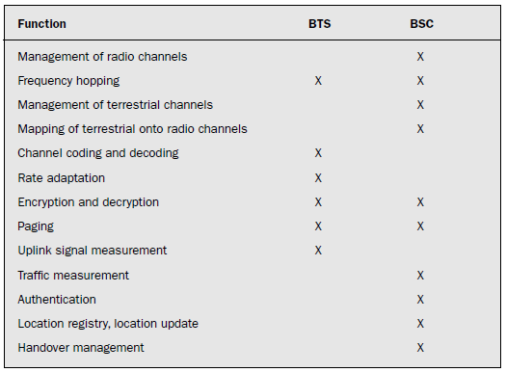
Tasks of the BTS and BSC

Slide 23
RSS Interfaces
Connection between the RSS and the NSS
A interface
The A interface is typically based on circuit-switched PCM-30 systems (2.048 Mbit/s),
Carrying up to 30 64 kbit/s connections.
Connection between the RSS and OSS
O interface
The O interface uses the Signalling System No. 7 (SS7) based on X.25
Carrying management data to/from the RSS.

Slide 24
Network and Switching Subsystem (NSS)
Connects the wireless network with standard public networks.
Performs handovers between different BSSs.
Comprises functions for worldwide localization of users .
Supports charging & Accounting.
Roaming of users between different providers in different countries.

Slide 25
NSS
Mobile services switching center (MSC)
High-performance digital ISDN switches
Set up connections to other MSCs and to the BSCs via the A interface
Form the fixed backbone network of a GSM system.
An MSC manages several BSCs in a geographical region.
A gateway MSC (GMSC)
Has additional connections to other fixed networks, such as PSTN and ISDN.
An MSC can also connect to public data networks (PDN) such as X.25
Need additional interworking functions (IWF).

Slide 26
NSS
Handles all signaling (standard signaling system No. 7 (SS7)) needed for connection setup, connection release and handover of connections to other MSCs.
Features of SS7 are number portability, free phone/toll/collect/credit calls, call forwarding, three-way calling etc.
Performs all functions needed for supplementary services such as call forwarding, multi-party calls, reverse charging etc.

Slide 27
Home location register (HLR)
Stores all user-relevant information
Comprises static information, such as
The mobile subscriber ISDN number (MSISDN),
Subscribed services (e.g., call forwarding, roaming restrictions, GPRS),
The international mobile subscriber identity (IMSI)
Dynamic information such as
The current location area (LA) of the MS,
The mobile subscriber roaming number (MSRN),
The current VLR and MSC

Slide 28
Contnd..
As soon as an MS leaves its current LA,
The information in the HLR is updated.
Is necessary to localize a user in the worldwide GSM network.
Supports charging and accounting
Can manage data for several million customers

Slide 29
Contnd..
Visitor location register (VLR)
dynamic database which stores all important information needed for the MS users currently in the LA that is associated to the MSC.
If a new MS comes into an LA the VLR is responsible for
It copies all relevant information for this user from the HLR
Avoids frequent HLR updates and long-distance signaling of user information.
Capable of managing up to one million customers

Slide 30
Operation Subsystem
Contains the necessary functions for network operation and maintenance.
Possesses network entities of its own and accesses other entities via SS7 signaling.
Operation and maintenance center (OMC)
Monitors and controls all other network entities via the O interface

Slide 31
OSS
OMC management functions are
Traffic monitoring,
status reports of network entities,
subscriber and security management,
Accounting and billing.
Use the concept of telecommunication management network (TMN).

Slide 32
OSS
Authentication centre (AuC)
Defined to protect user identity and data transmission.
Contains the algorithms for authentication as well as the keys for encryption
Generates the values needed for user authentication in the HLR.
Situated in a special protected part of the HLR.

Slide 33
OSS
Equipment identity register (EIR)
A database for all IMEIs
Has a blacklist of stolen (or locked) devices.
The blacklists of different providers are not usually synchronized
Also contains a list of valid IMEIs (white list), and a list of malfunctioning devices (gray list).

Slide 34
Channel Type
Physical Channels
Logical Channels
Traffic channels (TCH)
Control channels (CCH)

Slide 35
Traffic channels (TCH)
Transmit user data
Full-rate TCH (TCH/F)
Data rate of 22.8 kbit/s
The standard codecs for voice are called full rate (FR, 13 kbit/s).
Half-rate TCH (TCH/H)
data rate of 11.4 kbit/s
Doubles the capacity of the GSM system for voice transmission.
speech quality decreases
The standard codecs for voice are called half rate (HR, 5.6 kbit/s).

Slide 36
Contnd..
Enhanced full rate (EFR)
A newer codec provides better voice quality than FR as long as the transmission error rate is low.
The generated data rate is only 12.2 kbit/s.
Adaptive multi-rate (AMR, )
New codecs, which automatically choose the best mode of operation depending on the error rate .
Used together with 3G systems.

Slide 37
Contnd..
Tandem free operation (TFO).
An additional increase in voice quality is provided.
coding to and from PCM encoded voice (standard in ISDN) can be skipped and the GSM encoded voice data is directly exchanged.
Possible Data Rates
TCH/F4.8, TCH/F9.6, TCH/F14.4

Slide 38
Control channels (CCH)
To control medium access, allocation of traffic channels or mobility management.
Broadcast control channel (BCCH)
Used by BTS to signal information to all MSs within a cell.
Information transmitted in this channel is,
the cell identifier, options available within this cell, and frequencies available inside the cell and in neighboring cells.
Frequency correction channel (FCCH)
Synchronization channel (SCH)

Slide 39
Contnd..
Common control channel (CCCH)
All information regarding connection setup between MS and BS is exchanged.
The paging channel (PCH)
For calls toward an MS, the BTS uses for paging the appropriate MS.
The random access channel (RACH)
If an MS wants to set up a call, it uses to send data to the BTS.
The access grant channel (AGCH)
BTS uses to to signal an MS that it can use a TCH or SDCCH for further connection setup.

Slide 40
Dedicated control channel (DCCH)
Bidirectional channels
The stand-alone dedicated control channel (SDCCH)
A low data rate (782 bit/s) channel for signaling. used as long as an MS has not established a TCH with the BTS.
Comprise authentication, registration or other data needed for setting up a TCH.

Slide 41
Contnd..
Slow associated dedicated control channel (SACCH)
associated with each TCH and SDCCH.
Used to exchange system information, such as the channel quality and signal power level.
Fast associated dedicated control channel (FACCH)
Used if more signaling information needs to be transmitted and a TCH already exists
Uses the time slots which are otherwise used by the TCH.
Necessary in the case of handovers where BTS and MS have to exchange larger amounts of data in less time.

Slide 42
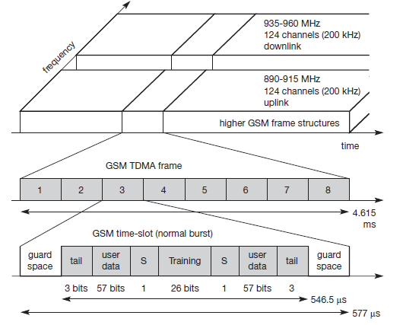
GSM TDMA Frame Structure

Slide 43
GSM TDMA Frame Structure
Each 200 kHz carrier is subdivided into frames that are repeated continuously.
Duration of a frame is 4.615 ms.
Subdivided into 8 GSM time slots.
each slot represents a physical TDM channel and lasts for 577 μs.
Each TDM channel occupies the 200 kHz carrier for 577 μs every 4.615 ms.

Slide 44
Contnd..
Bursts
Small portions in which Data is transmitted.
Only 546.5 μs long and contains 148 bits.
The remaining 30.5 μs are used as guard space to avoid overlapping with other bursts.

Slide 45
Normal Burst
Tail
The first and last three bits of a normal burst
All set to 0 and can be used to enhance the receiver performance.
The training sequence
Used to adapt the parameters of the receiver to the current path propagation characteristics and to select the strongest signal in case of multi-path propagation.
flag S -Stealing Flags
Indicates whether the data field contains user or network control data.
These two bits are set when a traffic channel burst has been ‘‘stolen” by a FACCH (the Fast Associated Control Channel).

Slide 46
Bursts
Frequency correction burst
Allows the MS to correct the local oscillator to avoid interference with neighboring channels,
Synchronization burst
Synchronizes the MS with the BTS in time, with an extended training sequence
Access burst
Used for the initial connection setup between MS and BTS,
Dummy burst
Used if no data is available for a slot.

Slide 47
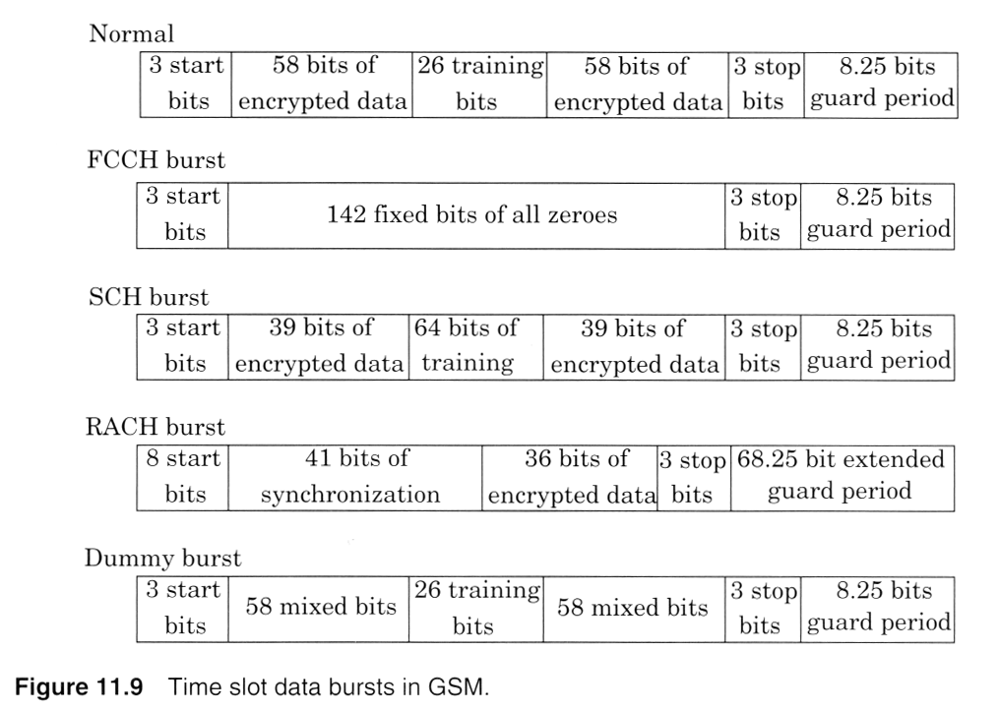

Slide 48
Contnd..
1 Burst = 156.25 bits
1 frame = 8*156.25 =1250 bits
1 Multiframe = 26 TDMA frames
1 Superframe = 51 multiframes
1 Hyperframe = 2048 superframes
A complete hyperframe is send every 3h 28m and 54s

Slide 49
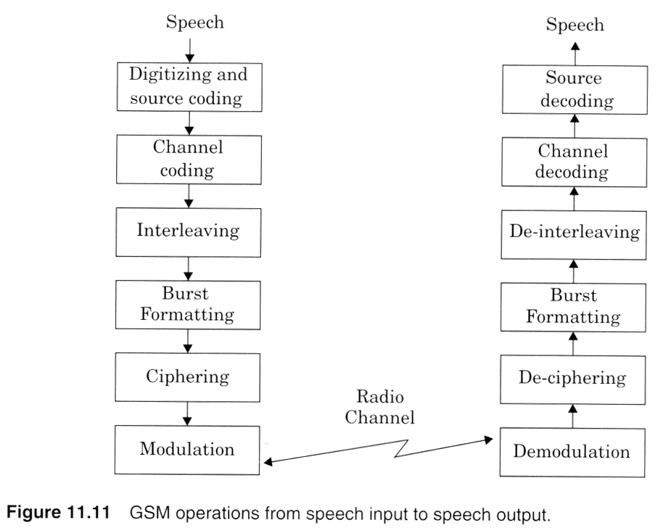
Signal Processing in GSM

Slide 50
Speech Coding
Based on Residually Excited Linear Predictive Coder (RELP).
Enhanced by including a Long-Term Predictor(LTP)
Provides 260 bits for each 20ms block of speech
Bit rate of 13kbps.
GSM operates in Discontinuous Transmission Mode (DTX)
Incorporating a voice activity detector (VAD)
Increases the battery life
Reduces the radio interferences
GSM transmitter is not active during silent periods
A comfort noise subsystem (CNS) at the receiving end
Introduces a background acoustic noise compensation

Slide 51
Channel Coding
TCH/FS, SACCH, FACCH
O/P of speech coder ordered into groups for error correction.
The most important 50bits (Ia) in the 260 bits frame have 3 parity check (CRC) bits.
Next 132 bits along with the 53 bits are reordered and appended by four trailing zero bits – 189 bits data block
This block is encoded using a rate ½ convolution encoder with constraint length K=5 for error protection – sequence of 378 bits
The least important 78 bits-no protection. Just concatenated.

Slide 52
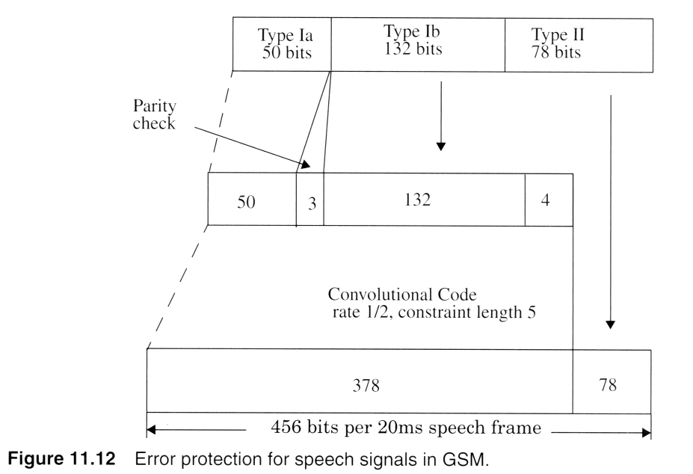

Slide 53
Channel Coding- Data Channels
Based on handling 60 bits of user data at 5ms intervals.
240 bits of user data are applied with four tailing bits to a half-rate punctured convolution coder with constraint length K=5.
Results in 488 coded bits – reduced to 456 bits
Data is separated into four 114 bit data bursts
Applied in an interleaved fashion to consecutive slots

Slide 54
Channel Coding for Control Channels
Control channel messages – 184 bits
Encoded using a shortened binary cyclic fire code, followed by a half rate convolution coder.
Fire code produces 184 message bits followed by 40 parity bits
Four tail bits are added
To clear the convolution coder – 228 bits data block
This block is applied to a half-rate K=5 convolution code using a generator polynomials G0 (x) and G1 (x)
Resulting 456 encoded bits are interleaved onto 8 consecutive frames .

Slide 55
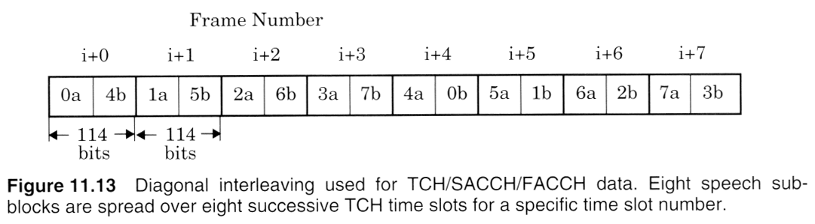
Interleaving
456 encoded bits are broken into 8 57bit sub-blocks
Minimizes the effect of sudden fades on received data.
8 Sub-blocks are spread over 8 consecutive TCH time slots
Each time slot carries two 57 bit blocks of data from two different 20ms speech/control segment.

Slide 56
Ciphering
Modifies the contents of 8 interleaved blocks through encryption techniques known only to MS and BTS.
Security is enhanced by changing the encryption algorithm call to call.
A3
Prevents unauthorized network access
Authenticate each mobile by verifying the users passcode with in the SIM with the key at the MSC
A5
privacy for the radio transmission
Provides scrambling for the 114 coded data bits

Slide 57
Burst Formatting
Adds binary data to the ciphered blocks
Helps synchronization and equalization of received signal

Slide 58
Modulation
0.3 GMSK Scheme
0.3-3dB bandwidth of the Gaussian pulse shaping filter with relation to the bit rate
Binary ones and zeros are represented in GSM by shifting the RF carrier by +_ 67.708 kHz.
Channel data rate is 270.83333kbps
Minimizes the BW occupied by the modulation spectrum & improves the channel capacity
Passed through a Gaussian filter to smooth the rapid frequency transitions.

Slide 59
Frequency Hopping
Normal case data burst transmitted using the same carrier frequency
In case of severe multi path problem;
Cell defined as a hopping cell
Slow frequency hopping may be implemented.
Carried out on a frame by frame basis
At a rate of 217.6 hops per sec
As many 64 channels used before repeating a hopping sequence
Specified by the service provider

Slide 60
Equalization
Performed at the receiver with the help of the training sequence.
Type not specified, left up to the manufacture.

Slide 61
Demodulation
Signal for a particular user is determined by;
The assigned time slot and Absolute radio frequency channel numbers
Appropriate TS is demodulated with the aid if synchronization data provided by the burst formatting
Binary info is deciphered, de-interleaved, channel decoded, and speech decoded

